Slide 1
Ad Victoriam, Ex Machina! Sed Est Tanti?
A deviation from how to use models vs why would we want to?

Slide 2
Outline
Core Issues
Significance
Sample Size
Accuracy Weight
Confidence
Utility
Implementation?
Usefulness?

Slide 3
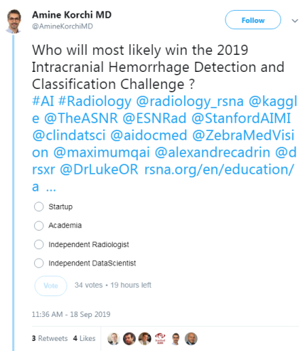
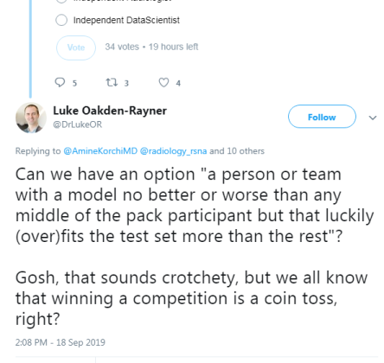
A Recent Critique:

Slide 4

Our Typical Goal(s)
When we construct a classifier, we’re typically building something that:
Identify what is or is not a cat.
Recognize faces
Target products
In medical imaging/genetics:
Identify a condition, disease, or disorder

Slide 5
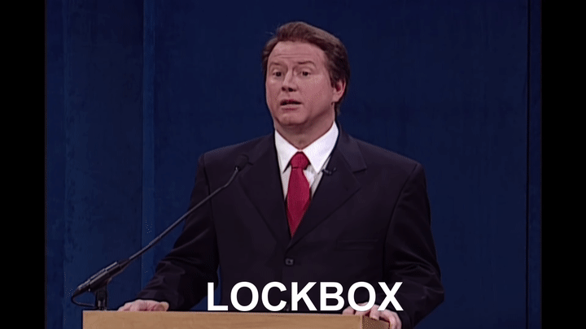
Goal: Who has what?
We do this in 2 phases:
Build the model based on the training data.
Test our model on the “hold out” or “lockbox” data.
From there:
Assess accuracy
Most accurate model wins

Slide 6
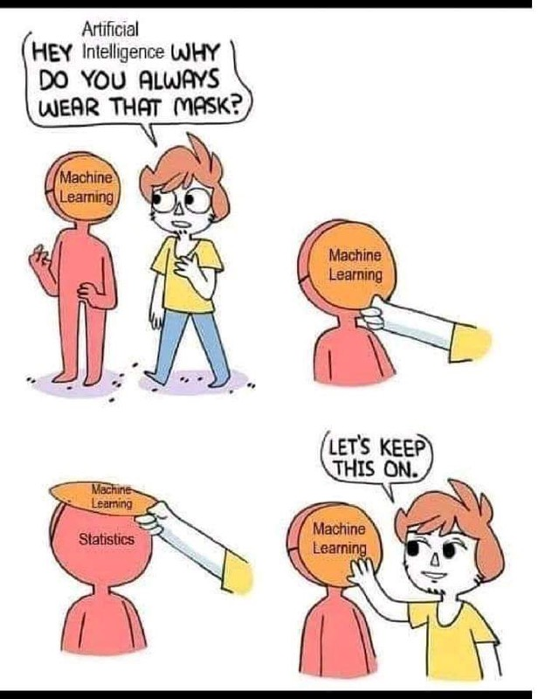
Goal: Who has what?
But this is a narrow view of model effectiveness.
Focusing on accuracy doesn’t really address:
“The Crapshoot/d20”
Confidence

Slide 7

The Crapshoot
Were we to make a general assumption:
50% accuracy for a 2 condition predictor is chance.
Anything greater than this is an improvement.
But that assumption is built upon an infinite number of features.

Slide 8

The Crapshoot
The crapshoot is the blue pill.
We can get arbitrarily accurate results.
Especially given that we’re constrained by sample sizes.

Slide 9

The Crapshoot
Furthermore:
We run X00~Inf number of models.
What if we were to correct for the total number of models?
What would be our critical p-values?

Slide 10
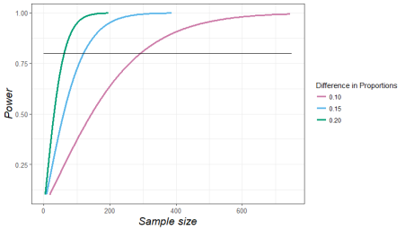
The Crapshoot

Slide 11
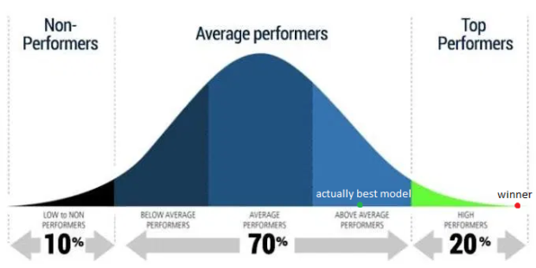
The Crapshoot

Slide 12
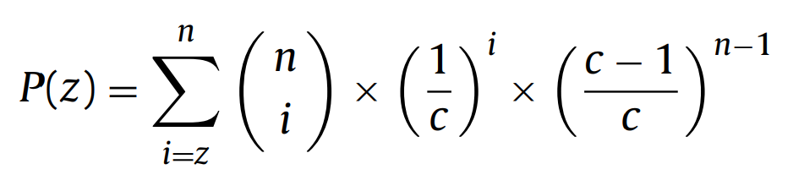
The Crapshoot
Since our success/failure can be tied to the number of subjects (we don’t have access to infinity…yet).
One can assess model significance under a NHT framework with the right adjustments.
n = number of samples
c = number of classes
z = probability to predict the correct c

Slide 13
The Crapshoot
Since our success/failure can be tied to the number of subjects (we don’t have access to infinity…yet).
One can assess model significance under a NHT framework with the right adjustments.
Methlab Matlab Example:
St(α) = binoinv(1 − α, n, 1/c) × 100/n
For n = 200, c=2, α = 0.05
56%

Slide 14
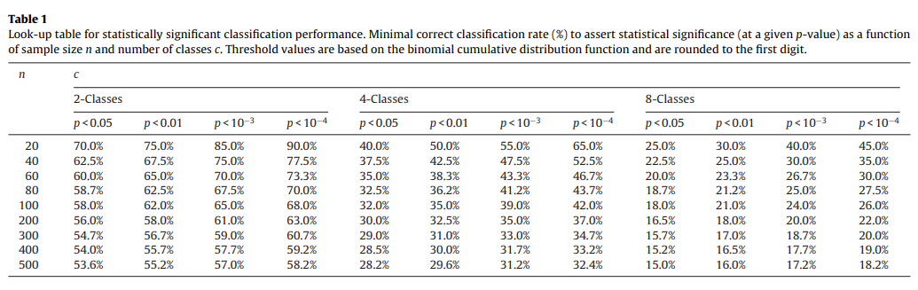

The Crapshoot

Slide 15
The Crapshoot

Slide 16
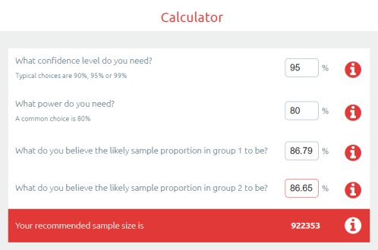
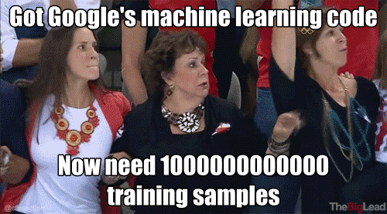
The Crapshoot

Slide 17
Confidence

Slide 18
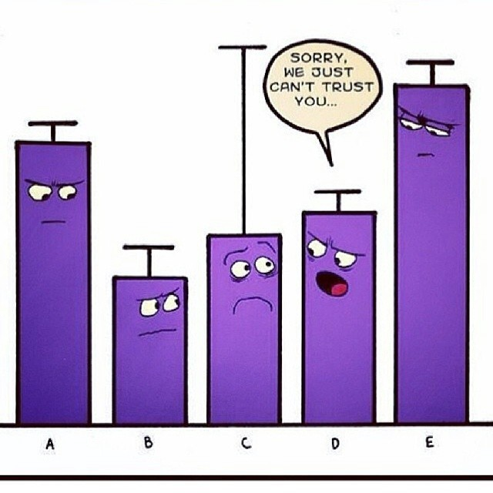
The Confidence
This is essentially a measure how “confident” we are that are prediction is:
Correct
Within an acceptable margin of error
You could also view this as an “effect size” of your classifier.

Slide 19

The Confidence
You can do this in many ways:
Probability of condition
Traditional/Frequentist Statistical confidence intervals (not recommended)
Bayesian Confidence Intervals (depends on your prior)

Slide 20
The Confidence
Asymptotic Intervals
Internal Confidence Intervals
Gamesman intervals

Slide 21
Confidence

Slide 22
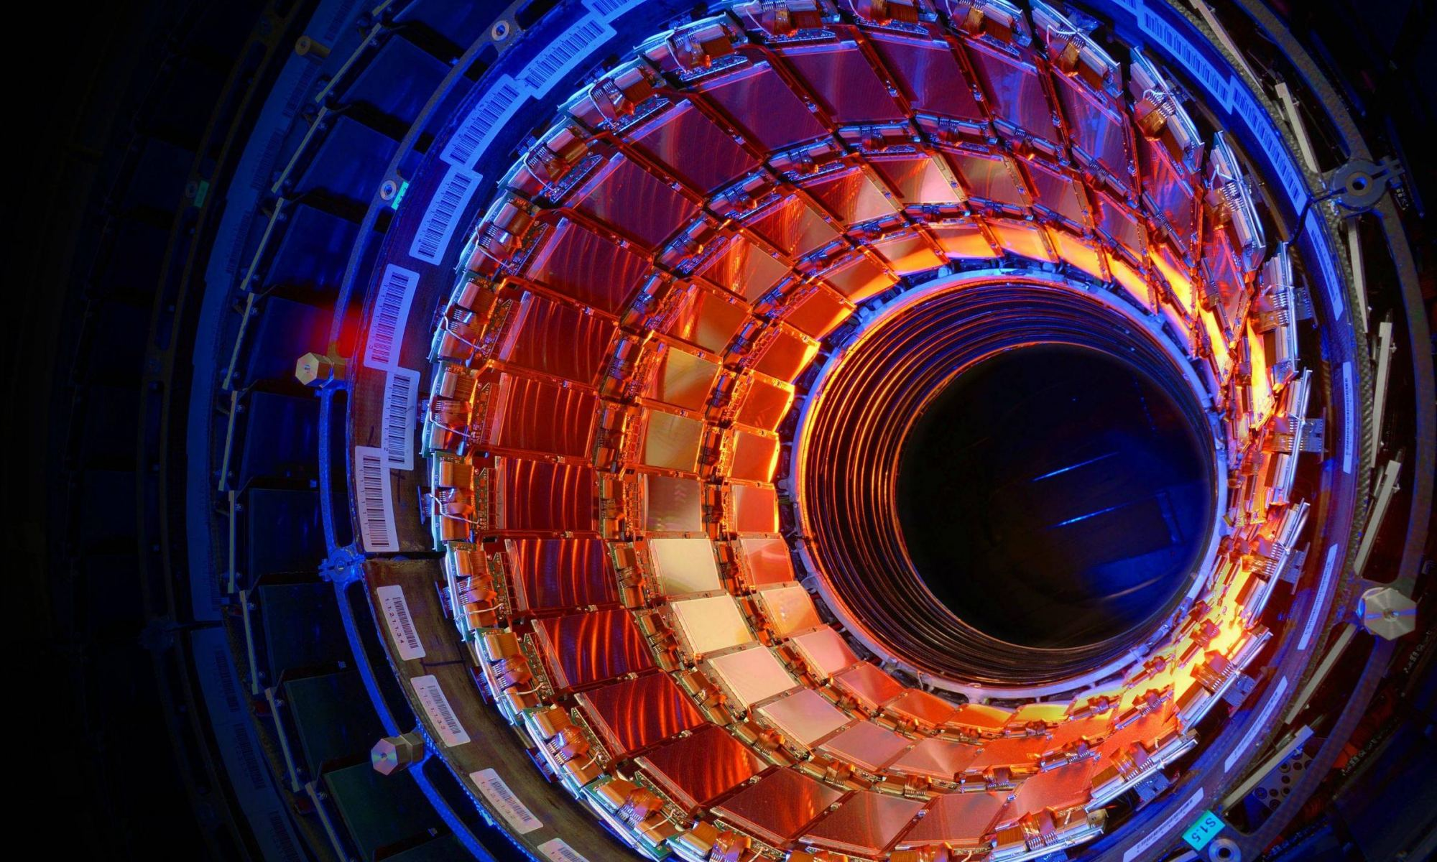
Deja-Vu
We have 40+ years of these same issues within high-energy physics literature.
Overfitting almost caused a revolution in the field that turned out to not actually exist.
Modern physicists have proposed their own solutions to these problems.
Dorigo, T. (2015). Extraordinary claims: the 0.000029% solution. In EPJ Web of Conferences (Vol. 95, p. 02003). EDP Sciences.

Slide 23
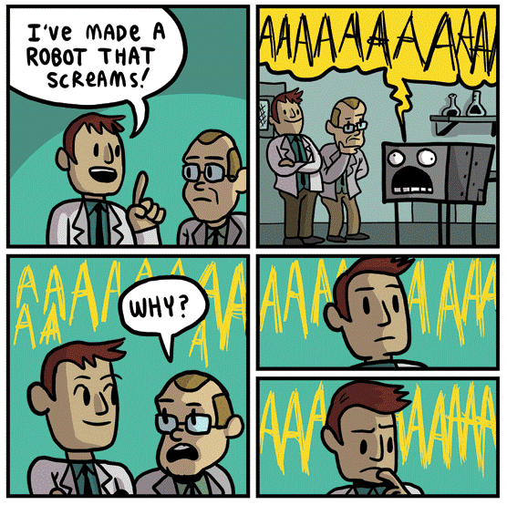
Utility
Probably THE most important thing to consider when building a model is:
……is this Useful?
Is it effective/relevant?
Is it accessible?
Does it reflect the nature of what it’s trying to classify?

Slide 24
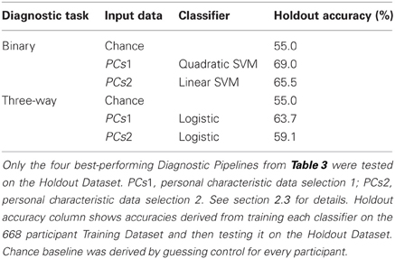
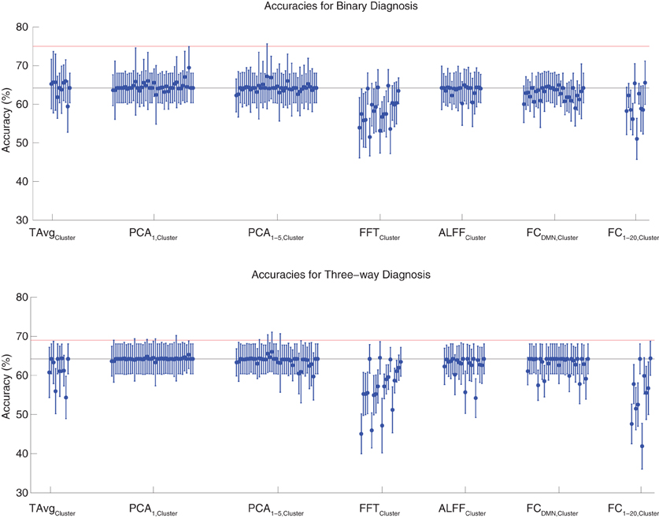
Utility
An example in feature selection:
ADHD-200 Global Competition
Winner: JHU 60.51%
Smug Winners: U Alberta 62.52%
Brown, M. R., Sidhu, G. S., Greiner, R., Asgarian, N., Bastani, M., Silverstone, P. H., ... & Dursun, S. M. (2012). ADHD-200 Global Competition: diagnosing ADHD using personal characteristic data can outperform resting state fMRI measurements. Frontiers in systems neuroscience, 6, 69.
http://fcon_1000.projects.nitrc.org/indi/adhd200/results.html

Slide 25


Utility
Asymptotic Intervals
Classification with HPC
~$280 million for the cluster
Overhead not included
Effectiveness?
Accessibility

Slide 26
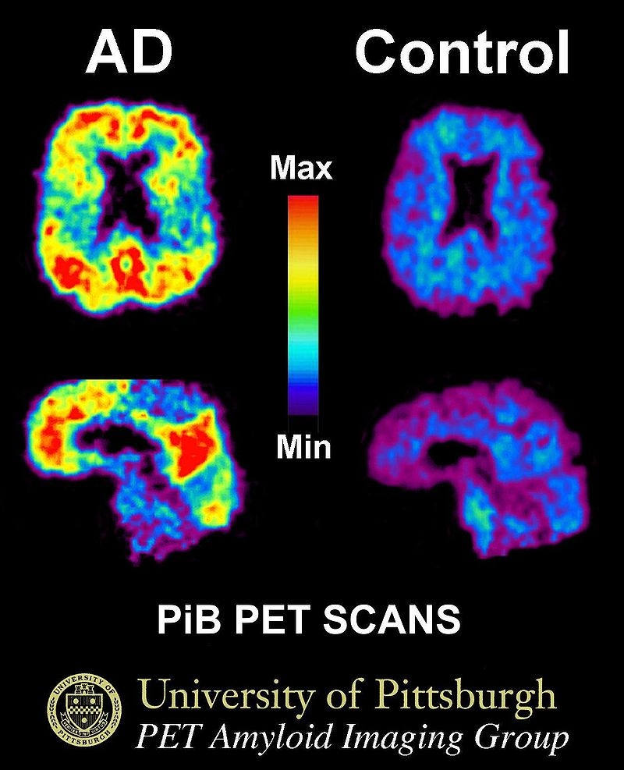
Utility
Pittsburg Compound B for Alzheimer’s dementia
EXTREMELY EFFECTIVE
Invasive
Medicare and most insurance companies have not decided whether they will cover the cost
$3000–6000
Late in the game
Roberts, J. Scott, Laura B. Dunn, and Gil D. Rabinovici. "Amyloid imaging, risk disclosure and Alzheimer’s disease: ethical and practical issues." Neurodegenerative disease management 3.3 (2013): 219-229.

Slide 27
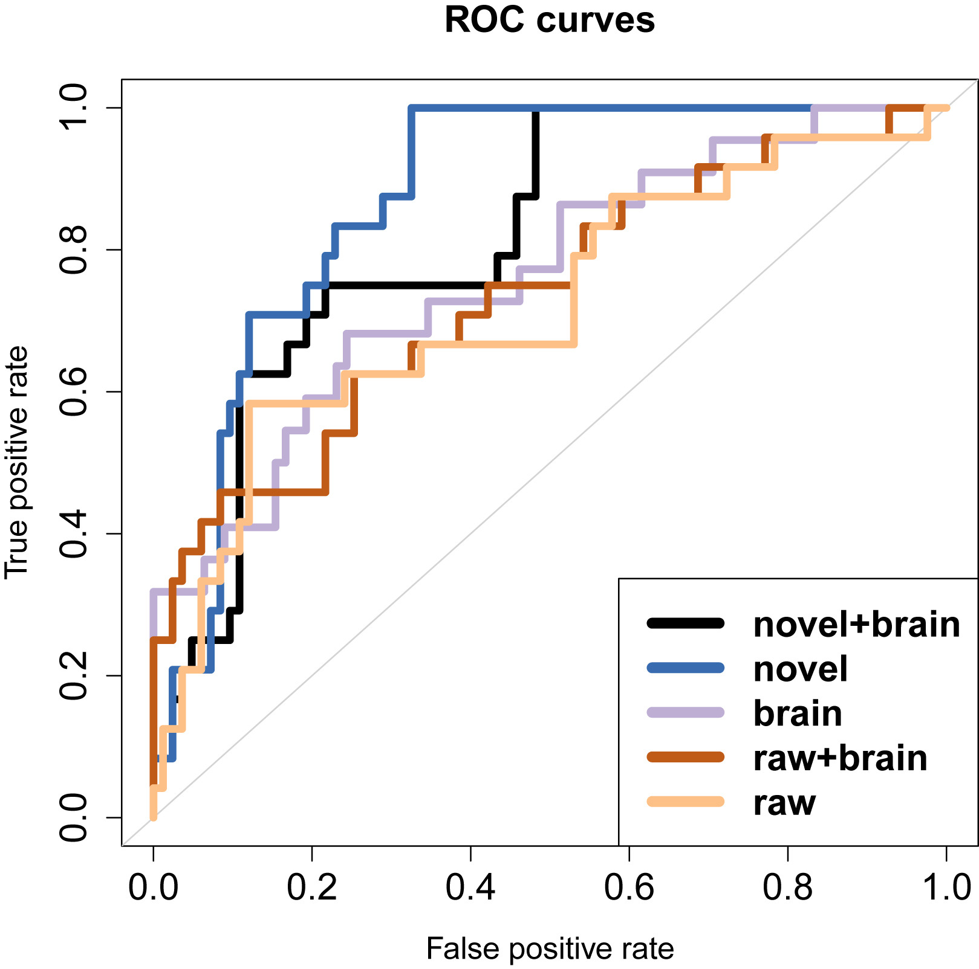
Utility
Alzheimer’s classification using verbal fluency scores
Acquired in ~10 minutes
Non-invasive
Can be detected early
Clark, D. G., McLaughlin, P. M., Woo, E., Hwang, K., Hurtz, S., Ramirez, L., ... & Apostolova, L. G. (2016). Novel verbal fluency scores and structural brain imaging for prediction of cognitive outcome in mild cognitive impairment. Alzheimer's & Dementia: Diagnosis, Assessment & Disease Monitoring, 2, 113-122.

Slide 28
